Slide 1
Week 2
Trust and Ethics

Slide 2
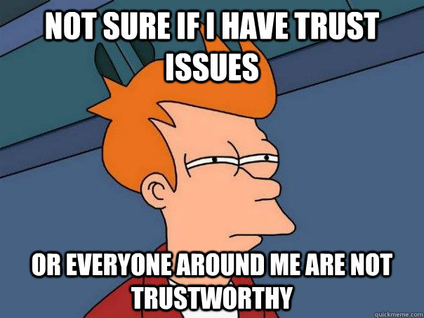
Trust
Confidence placed in a person by making that person the nominal owner of property to be held or used for the benefit of one or more others.
Transitive trust
Certificates and digital signatures

Slide 3
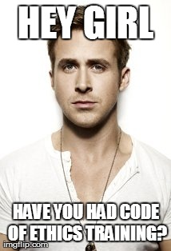
Ethics
Moral principles that govern a person's behavior or the conducting of an activity.

Slide 4
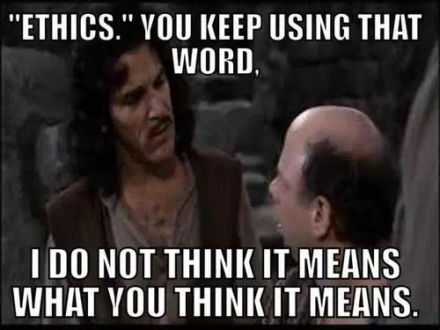
Ethics example
In the course of your job you find confidential info relating to mental health about someone who babysits your child, what do you do?
You are scheduling a meeting with a client, it turns out this client requested a meeting at 3pm on a Friday near your house. Do you go home or back to work if the meeting ends early?
You're at work or school and you're getting all the credit on a team project, do you say anything?

Slide 5
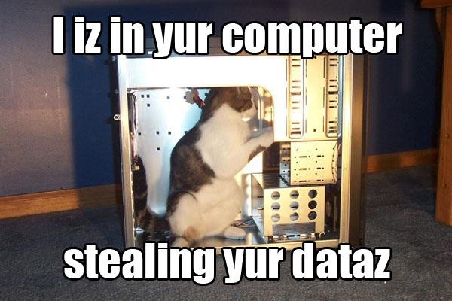
Hackers
White hat
Grey hat
Black hat

Slide 6
Ethics in Computer Security : People
Kevin Mitnick
13 bypassed bus ticket system
Copying of software
Edward Snowden
CIA & NSA leaks

Slide 7
Ethics in Computer Security : Hacker groups and Hacktivists
Anonymous
Occupy Wallstreet
War on the Church of Scientology
Lulzsec
Sony pictures
CIA website
Chaos Computer Club
Headquarters in Germany
Publisher of magazine Datenschleuder

Slide 8
Ethics small group discussions
You must discuss your topic together then share the highlights of the conversation with the class .
Is it ever ok to pirate content(Movies, games, software etc.)
Is information on a company device considered private? What about accounts logged in to that device?
When should your data belong to you?
Should companies be able to see your credit score? What about require your login for social networking sites?
What if any countries laws should apply to the internet?
Is Hacktivism ever ok? When should it be legal? Illegal?

Slide 9
Ethics in Computer Security examples
Schools putting loggers and RATs on loaned laptops
Reading emails from coworkers as you work in IT
Hearing information about the company before others
Data monitoring or changing at coworker and bosses request

Slide 10
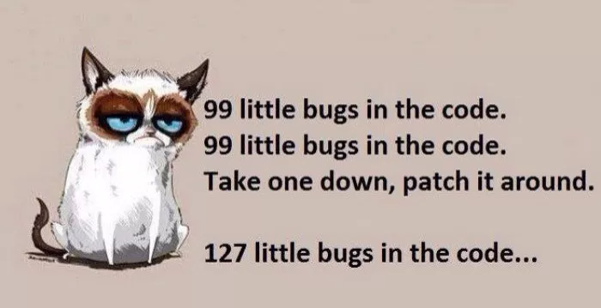
Ethics: How to handle Bugs
Patch times
Bug prioritization
Patch cycle

Slide 11
Ethics: How to do bug disclosure
Responsible disclosure
Allows stakeholders time to fix bugs
Full disclosure
Tells the public everything

Slide 12
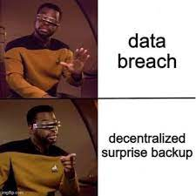
Ethics: How to do Breach Disclosure
Security breach disclosure laws
https://en.wikipedia.org/wiki/National_Conference_of_State_Legislatures
Equifax disclosure= Dumpster Fire
TJX
RSA

Slide 13
Ethics: Data exfiltration
Steganography
Ipods (podsnarfing)
Cameras
Usb drives (thumbsucking)
Bluetooth (bluesnarfing)
Sneakernet

Slide 14
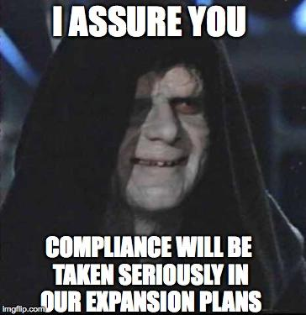
Compliance
Certification or confirmation that the doer of an action (such as the writer of an audit report), or the manufacturer or supplier of a product, meets the requirements of accepted practices, legislation, prescribed rules and regulations, specified standards, or the terms of a contract.
http://www.businessdictionary.com/definition/compliance.htmlhttp://www.businessdictionary.com/definition/compliance.html

Slide 15
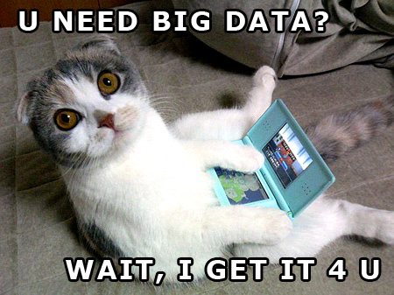
Federal Data Handling
HIPAA
FERPA
Sarbanes Oxley
PCI-DSS (payment cards)

